Slide 1
Angular Services

Slide 2
Pros and cons of Component
Component should provide logic to support view
It should not deal with external data.
It can’t control behavior of more one component.
In cannot share data between components

Slide 3
What is Angular Service?
A class with specific purpose
It used to share data among different components
It implements application logic
It controls external interaction
It helps to avoid repetition

Slide 4
World without Services
Agenda:
Create two component : emp-list and mp-details.
Create data set for employee in emp-list component.
Create same dataset for employee in emp-detail

Slide 5
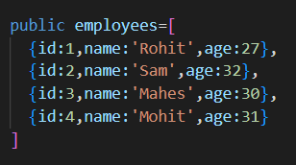
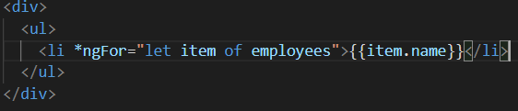


World without Services

Slide 6
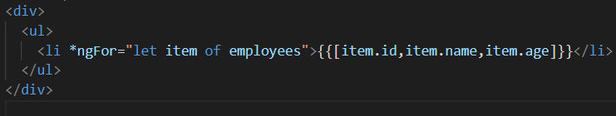

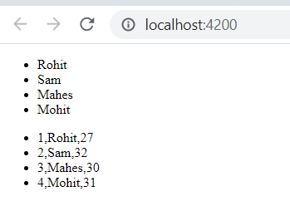
World without Services

Slide 7
World without Services
Conclusion:
We have to repeat the data if we need the same data.
Efficiency is reduced, because we need to create the same data set multiple time
Storage requirement is huge

Slide 8
We need better world: World of services
Same data , multiple use
Better information share among components
Improved efficiency by reducing over head of maintaining multiple of copy of same data.

Slide 9
An Example Without Service
The course of action:
Create a class with data. This class returns data whenever it is required.
In every component where the data is required instantiate one object of that class
Using the class method to get the data

Slide 10
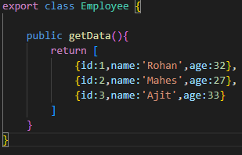
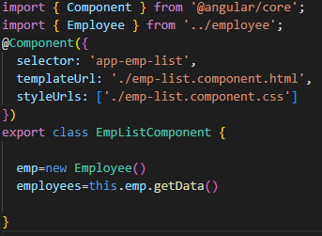
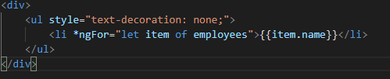
An Example Without Service

Slide 11
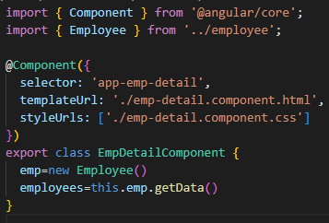
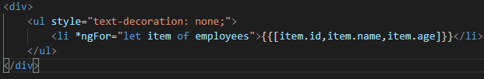
An Example Without Service

Slide 12
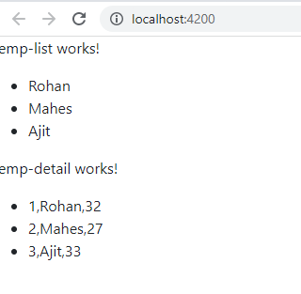
An Example Without Service

Slide 13
An Example Without Service
In the previous example we did manage to reduce the repetition of data storage. But could not manage to improve efficiency.
The number of times the we call the to instantiate object a new object is created and any modification is restricted to local change.

Slide 14
Concept of Dependency
A class is called dependent on when it depends on other class to make itself complete.
For example, we have engine and tire class. Now, if we want make Car class we need these two classes. So, class Car is dependent on engine and tire class.

Slide 15
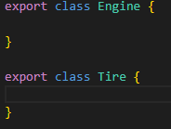
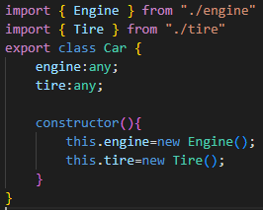
Concept of Dependency

Slide 16
Concept of Dependency
The problem with our code is the car class is not flexible and robust to changes.
Suppose, engine can of different types: diesel or petrol. Tires may be of old or new, their brand may be different.
The dependent classes may have dependencies themselves.

Slide 17
Dependency Injection
Its is the design pattern in which a class receives dependencies without creating themselves,
Dependency injection is a programming technique that makes a class independent of its dependencies.
It achieves that by decoupling the usage of an object from its creation.

Slide 18
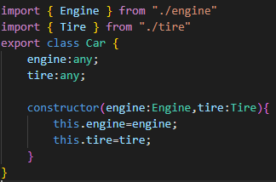
Dependency Injection
Without DI
With DI

Slide 19


Dependency Injection
By changing parameter we can introduce flexibility->Dependency Injection

Slide 20
Dependency Injection
We can improve dependency relationship, if we introduce dependency injection.
But, still we need to create all the dependencies. What if we need 20 dependencies to create our class.
var B=new dependecy()
var C=new dependecy()
var D=new dependecy()
var E=new dependecy()
var F=new dependecy()
var G=new dependecy()
var H=new dependecy()
var A=new MyClass(B,C,D,E,F,G,H)
var B=new dependecy()
var C=new dependecy()
var D=new dependecy()
var E=new dependecy()
var F=new dependecy()
var G=new dependecy()
var H=new dependecy(newA)
var A=new MyClass(B,C,D,E,F,G,H)

Slide 21
Dependency Injection
DI As a framework
Injector
Engine ServiceA
Tire ServiceB
depA ServiceC
depB ServiceD
debC ServiceE
. .
. .
. .

Slide 22
Dependency Injection
The employee details example with dependency.
Define employeeService class
Register with injector
Declare as dependency in emp-list and emp-details.
EmployeeService
Injector
Emp-list
Emp-detail

Slide 23

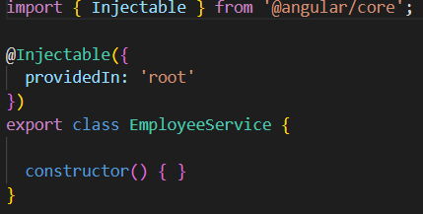
Dependency Injection
Step1: Generate employee service using ng tool
ng generate service employee
employee.service.ts

Slide 24
Dependency Injection
After creation of service we need to register the service.
If we don’t register, angular will treat as regular class.
Now question is: where should we register?
To understand the answer we need to know hierarchy system in angular

Slide 25
Dependency Injection
The place of service register is very important
AppModule
AppComponent
emp-details does not have access to service
Injector
emp-list
emp-details
Service available to the complete sub tree
child
This level of injection is not good choice

Slide 26
Dependency Injection
Changing the place of service register to AppComponent
AppModule
Injector
AppComponent
emp-list
emp-details
Service available to the complete sub tree
child
Service available to the complete sub tree

Slide 27
Dependency Injection
Changing the place of service register to AppModule
Since AppModule is on top of every feature of Angular, we should register everything in it
Injector
AppModule
AppComponent
emp-list
emp-details
Service available to the complete sub tree
child
Service available to the complete sub tree

Slide 28

Dependency Injection Example
Step 1: use ng tool to create a service of name employee
ng generate service employee
Or, in short
ng g s employee
Two files are created

Slide 29
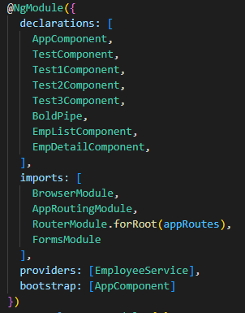
Dependency Injection Example
Step 2: Register the in app.module.ts
2.1: Import service
2.2: Put in providers
Note: Providers are just a function that instantiate the service outside the component that uses it

Slide 30
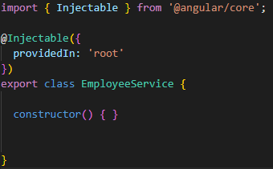
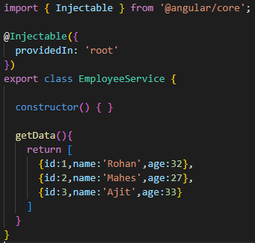
Dependency Injection Example
Step 3: Modify the service code, in employee.service.ts
The skeleton of service file
Service file after modification

Slide 31
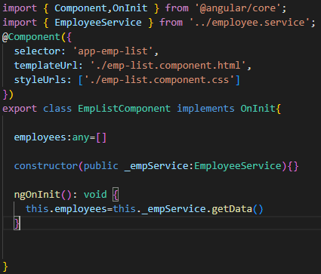
Dependency Injection Example
Step 4: Inject the service into the emp-list components
Import OnInit
Import employee service
Implements OnInit on component class
Create an empty list
Inject the dependency using constructor
Use ngOnInit to fetch data from service and store it inside empty array

Slide 32
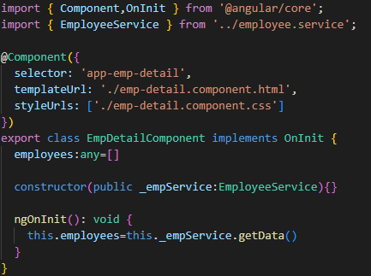
Dependency Injection Example
Step 4: Inject the service into the emp-details components
Same steps we need to follow in this example also

Slide 33
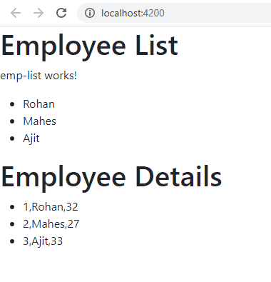
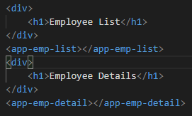
Dependency Injection Example
app.component.html

